Slide 1

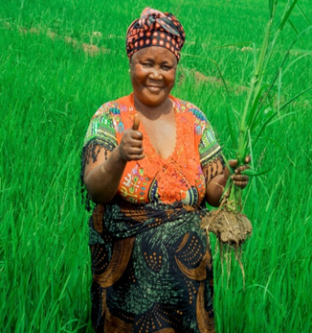
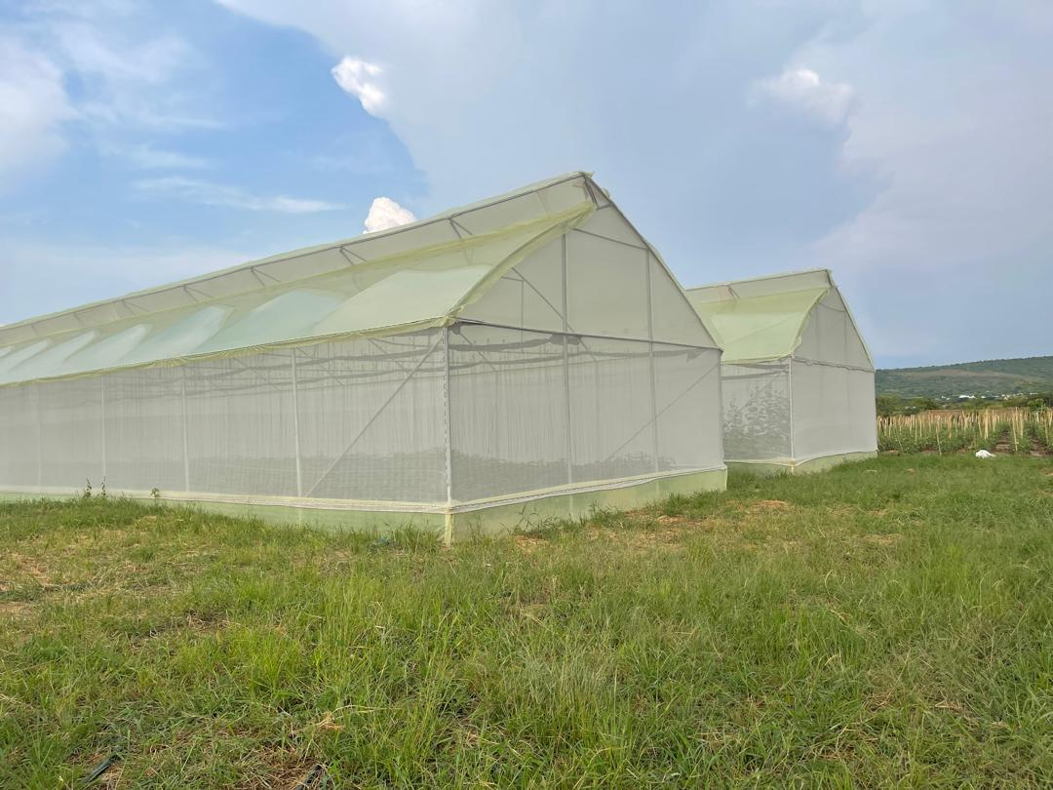
FP179 Tanzania Climate Adaptation Technology Deployment Programme (TACATDP) Implementation progress report - 2025

Slide 2



CONTENT TACATDP Programme Implementation Status as 2025

Slide 3
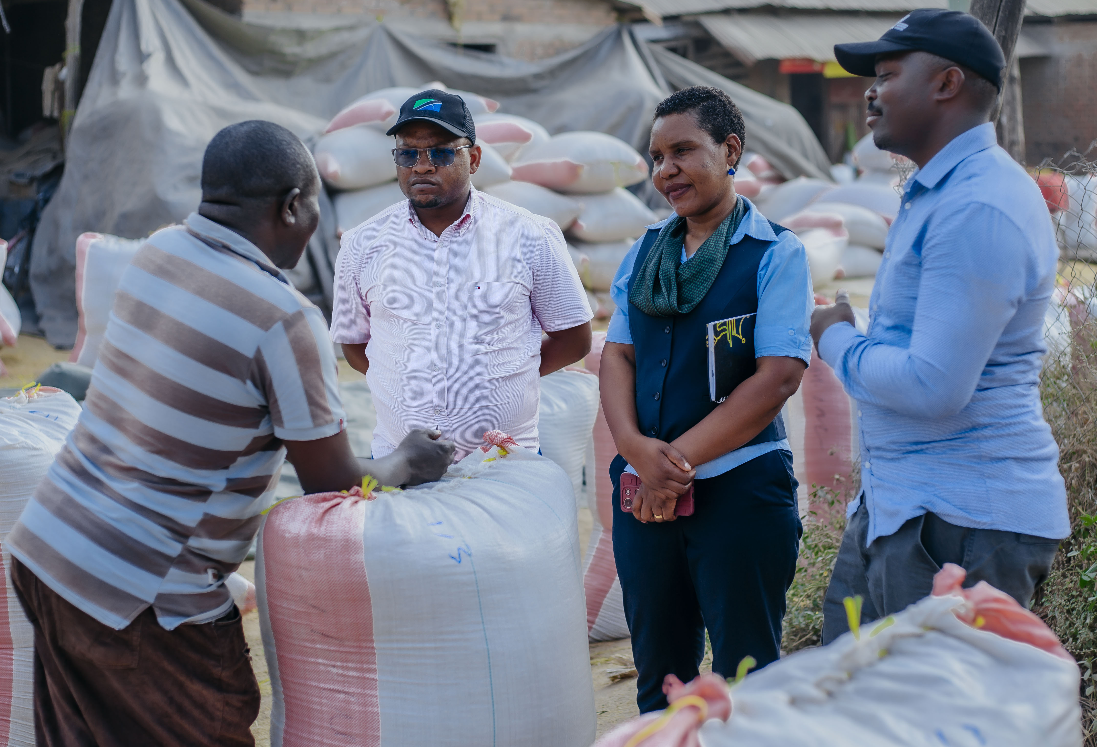
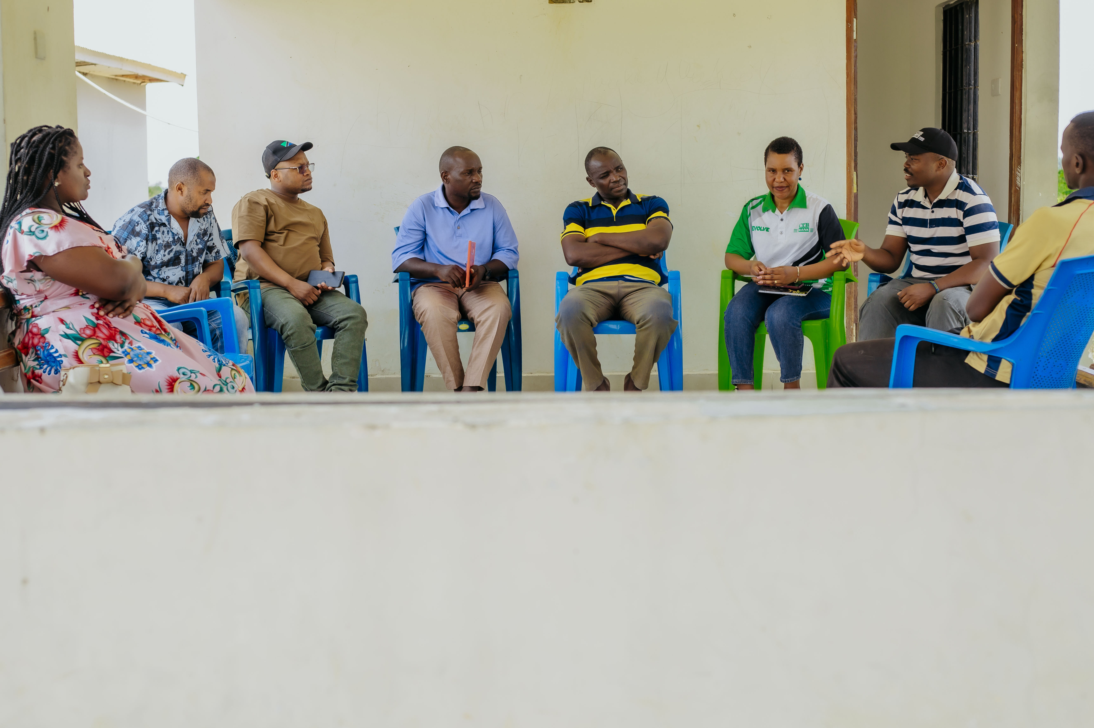
i
TACATDP Progress December 2025
During the year 2025 he programme demonstrated strong delivery through TZS 107.31 billion disbursed as direct loans to direct 1,023 borrowers, reaching 616,115 as total beneficiaries, including 58% women, while supporting climate-smart agriculture technologies such as efficient irrigation systems, post-harvest storage, crop processing for value addition, resilient seeds, mechanization and value-chain financing. The report also highlights practical cases such as impact testimonials from selected farmers, LORTA baseline work covering 3,000 households, development of an integrated monitoring tool, and strengthened collaboration with GCF, National Designated Authority of Tanzania (i.e Vice President Office), CRDB Relationship Managers, Independent Evaluation Unit of GCF, service providers and other TACATDP partners, while justifying continued GCF support to ensure that, this programme proves as an exemplary programme not only in Tanzania but within Africa region.

Slide 4
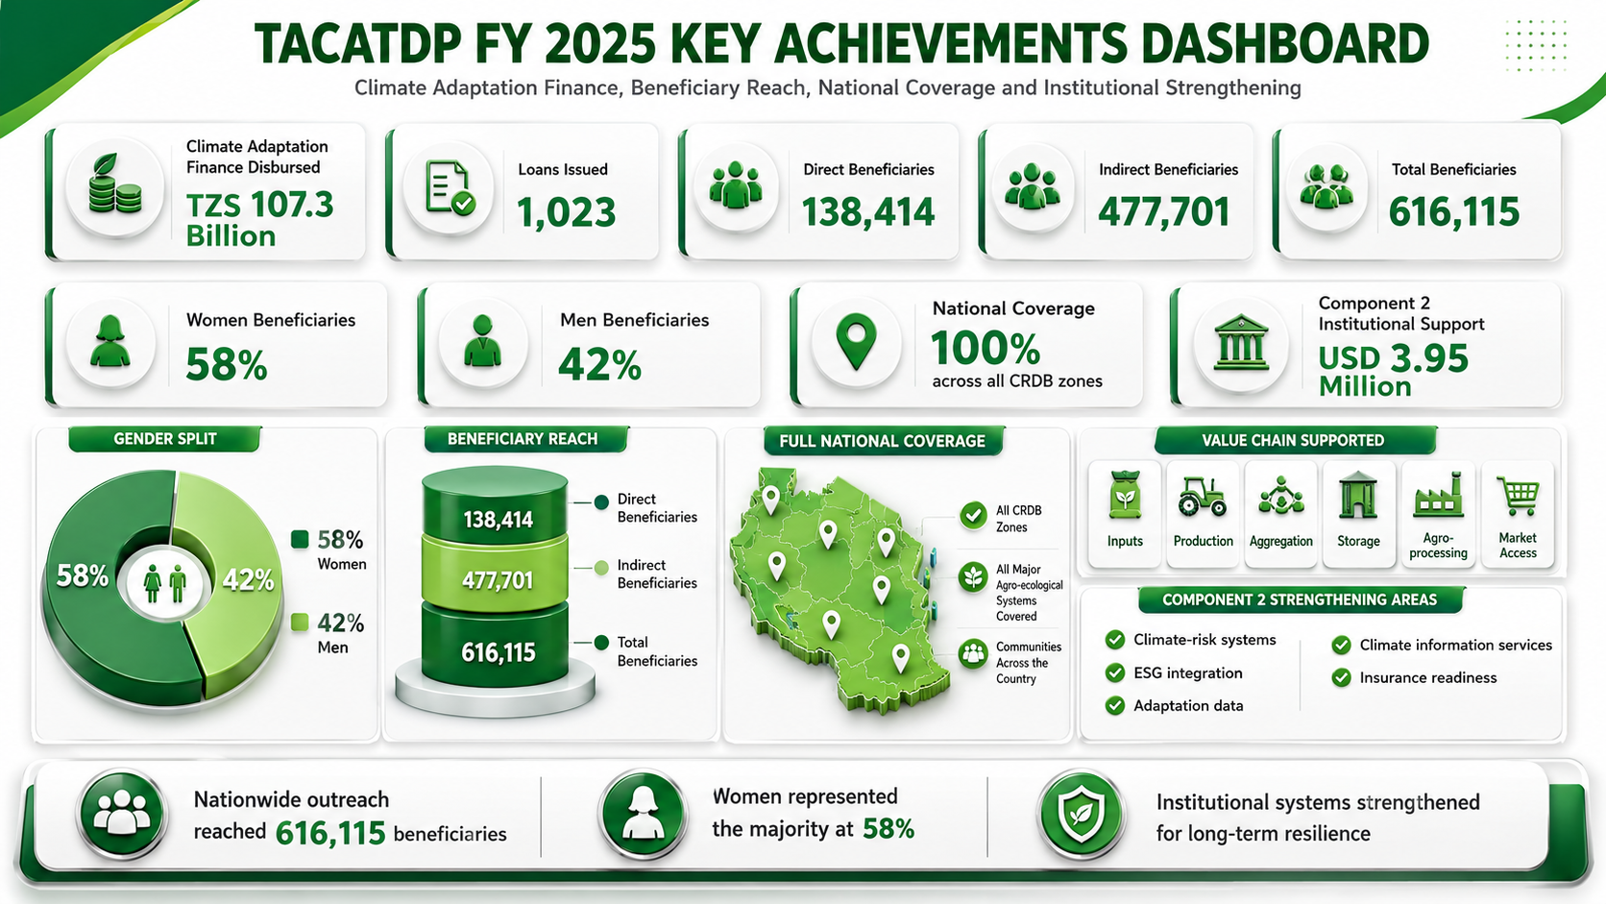


Slide 5

TACATDP: YEAR 2025 GEOGRAPHICAL DISTRIBUTION OF FINANCING OUTREACH

Slide 6
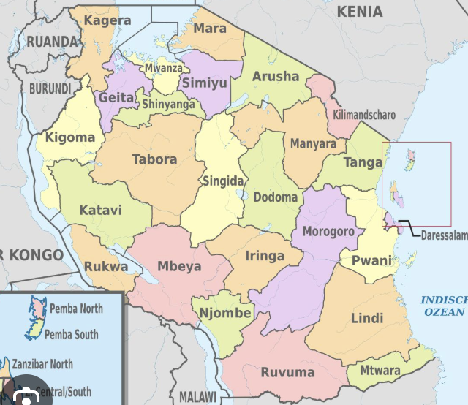
TACATDP Loans Disbursement per region as of 31st December 2025
TACATDP LOANS DISBURSEMENT PER REGION
S/N | REGION | AMOUNT IN TZS | NUMBER OF DIRECT BORROWERS
1 | KATAVI | 2,668,000,000 | 7
2 | NJOMBE | 1,243,504,000 | 251
3 | MBEYA | 752,208,333 | 52
4 | SONGWE | 7,364,000,000 | 8
5 | GEITA | 163,000,000 | 7
6 | TABORA | 766,105,000 | 37
7 | SHINYANGA | 1,025,000,000 | 10
8 | KIGOMA | 453,562,400 | 18
9 | SIMIYU | 534,450,000 | 8
10 | KAGERA | 1,493,500,000 | 45
11 | MWANZA | 555,940,000 | 16
12 | MARA | 100,000,000 | 6
13 | DAR ES ES SALAAM | 4,565,000,000 | 45
14 | ZANZIBAR | 45,000,000 | 3
15 | COASTAL | 481,481,000 | 47
16 | MOROGORO | 303,000,000 | 31
17 | IRINGA | 245,890,000 | 51
18 | DODOMA | 60,582,000,060 | 22
19 | SINGIDA | 127,890,000 | 5
20 | ARUSHA | 1,578,200,000 | 19
21 | KILIMANJARO | 3,230,000,000 | 17
22 | MANYARA | 1,485,550,350 | 143
23 | TANGA | 83,500,000 | 5
24 | RUVUMA | 5,000,000,000 | 46
25 | MTWARA | 4,000,000 | 1
26 | RUKWA | 500,000,000 | 5

Slide 7
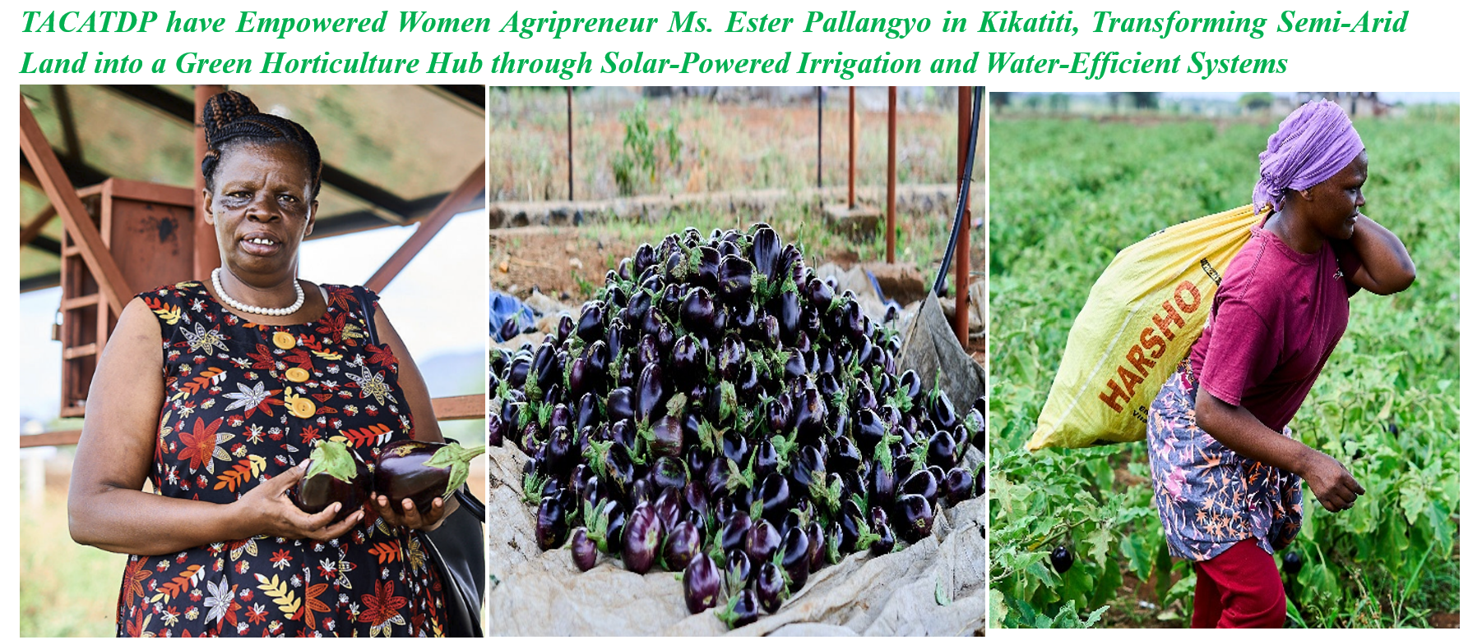
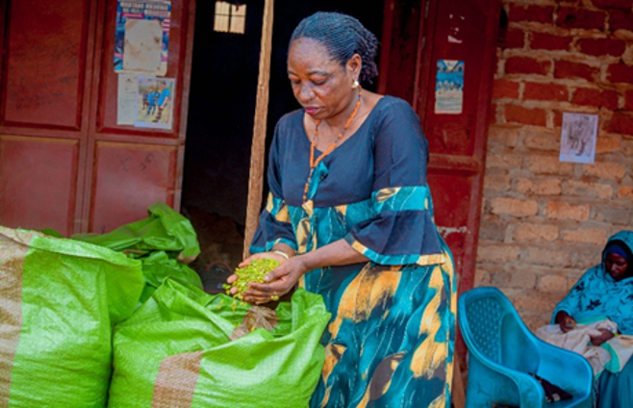
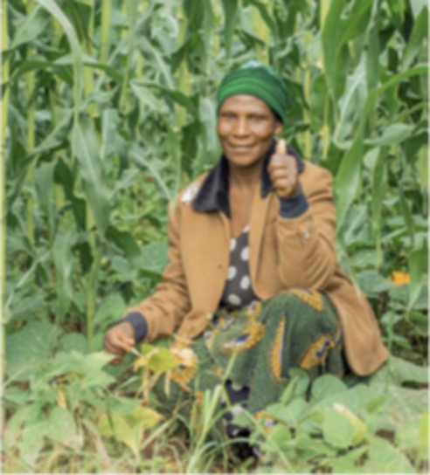
TACATDP impacts in the fields through concessional financing support
Gender Action Plan and youth inclusion remain one of key focus TACATDP, with women accounting for 58% of beneficiaries. The programme supports women-led enterprises and promotes gender-sensitive financial products.
Women Primary producer
Women MSME Storage and aggregator
Women MSMEs Agro-processing and Value Addition

Slide 8
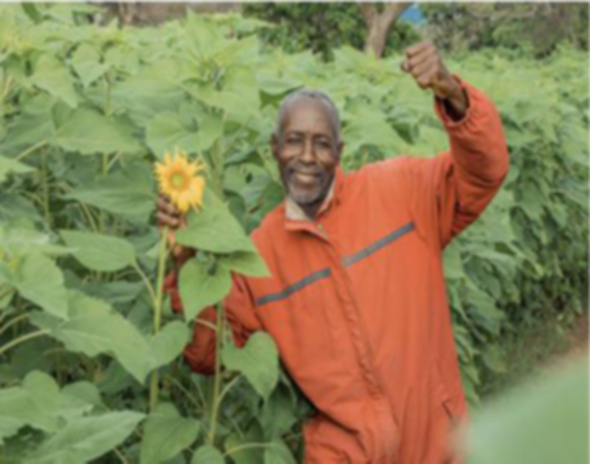
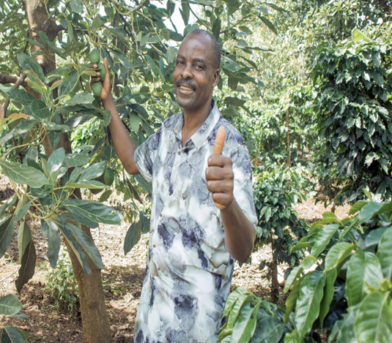
TACATDP impacts various food crops
Avocado farmer
Sunflower farmer

Slide 9
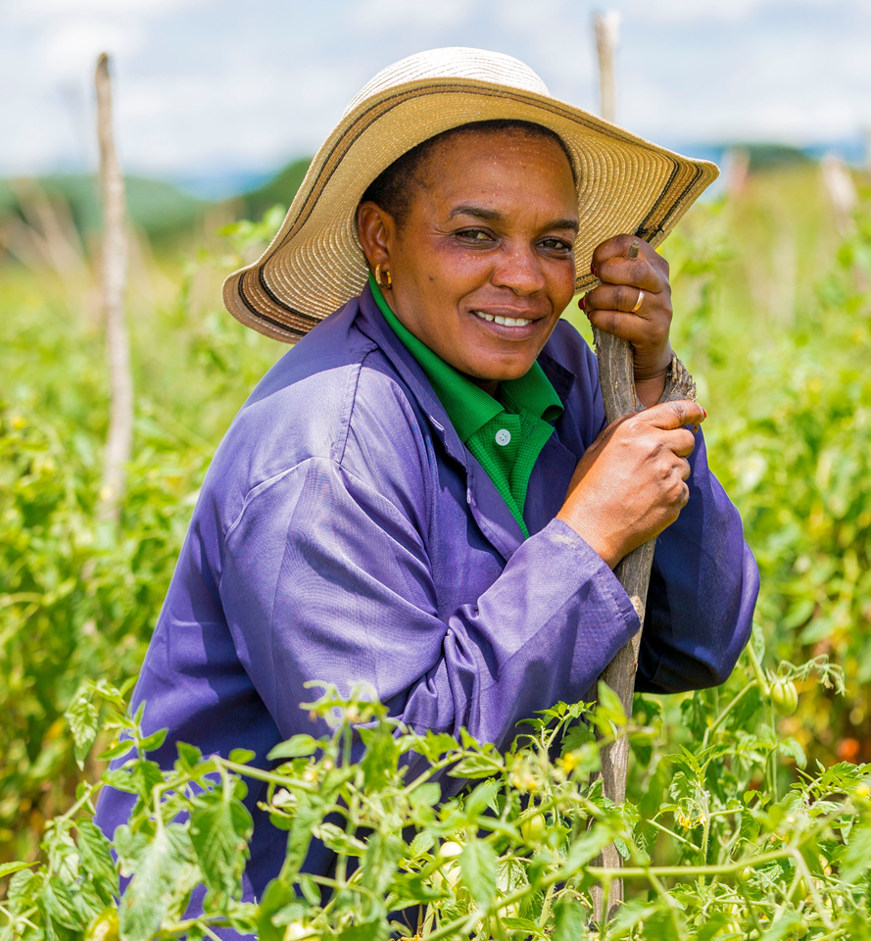
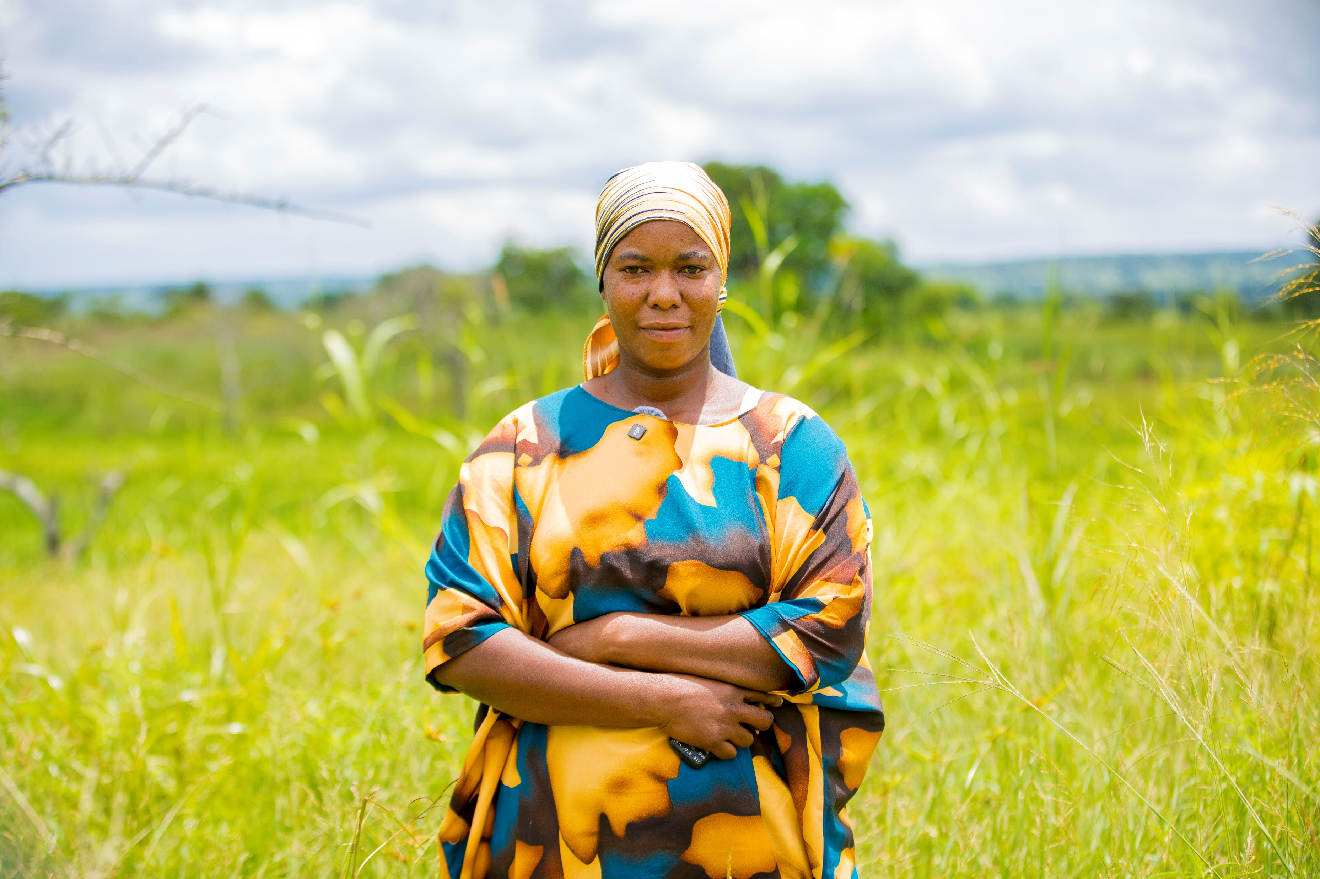
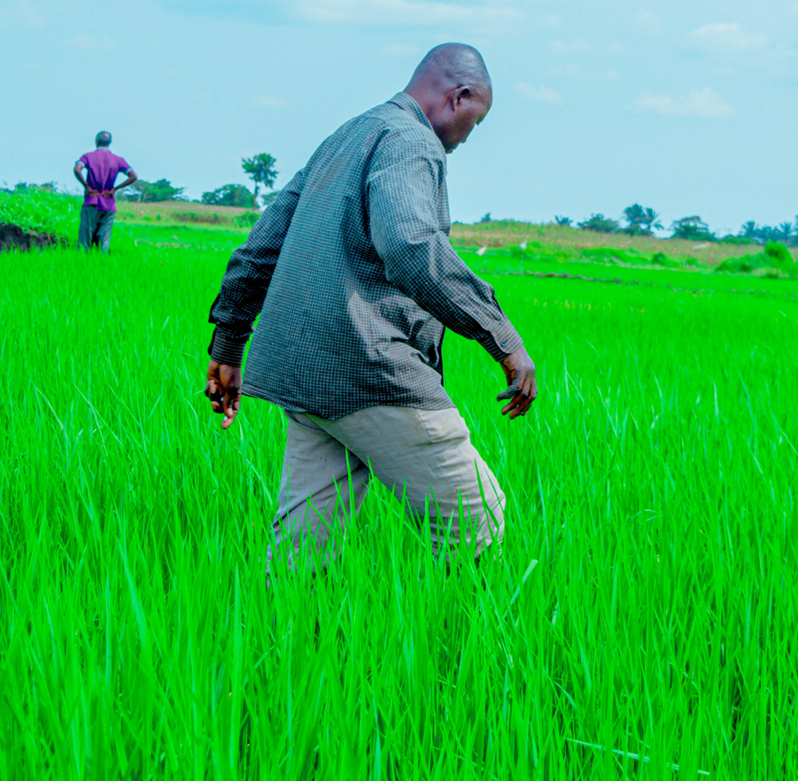
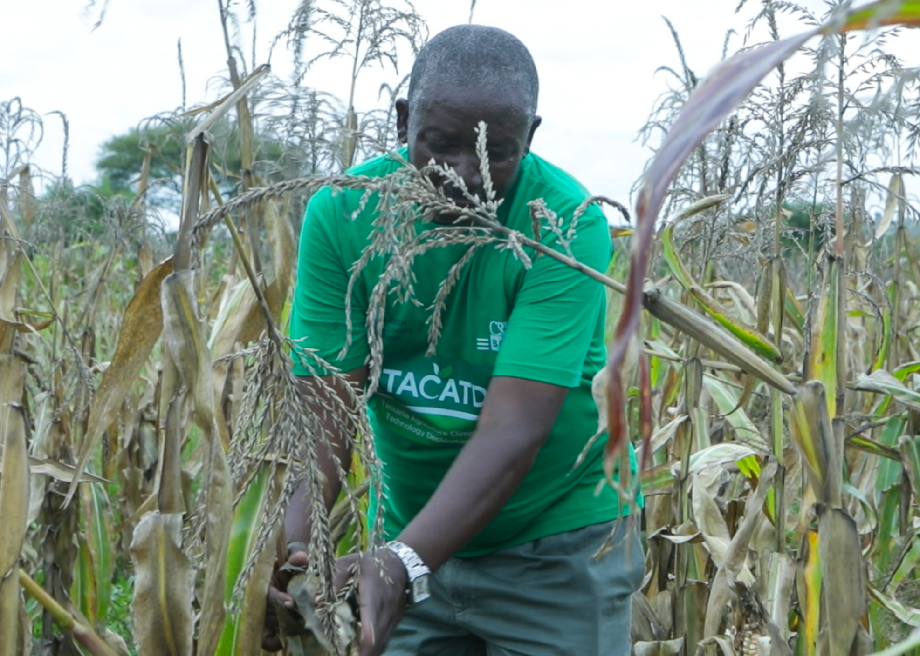
TACATDP impacts various segments and value chains
Horticultural Farmers
Mixed farming farmer
Sunflower farmer
Paddy farmer
Maize harvesting

Slide 10
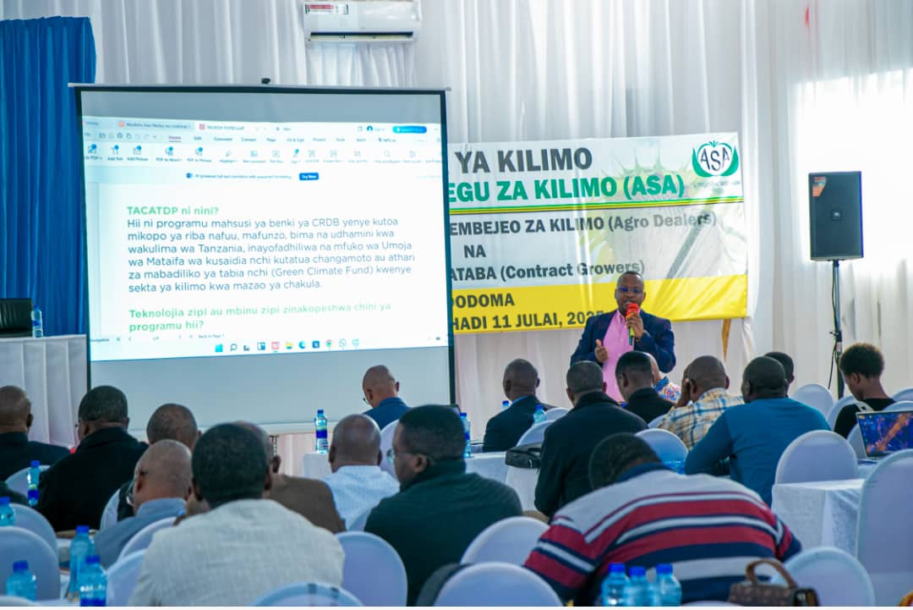
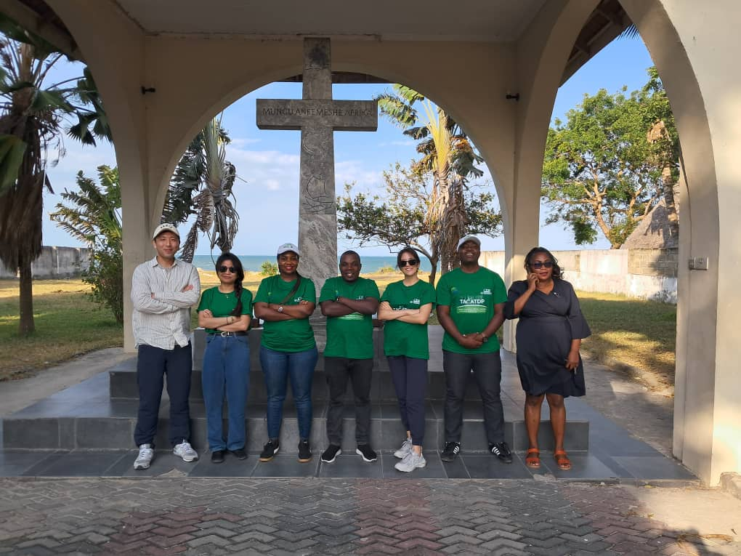
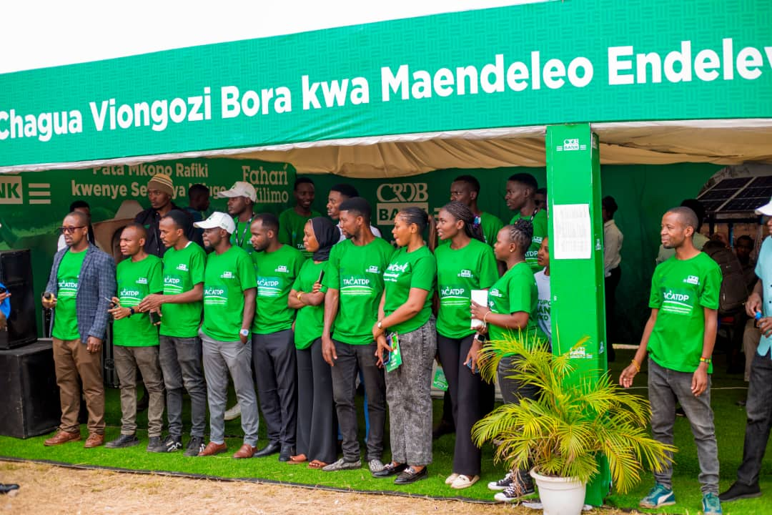
Training, capacity building and agri fare exhibitions are part of TACATDP
Sunflower farmer

Slide 11
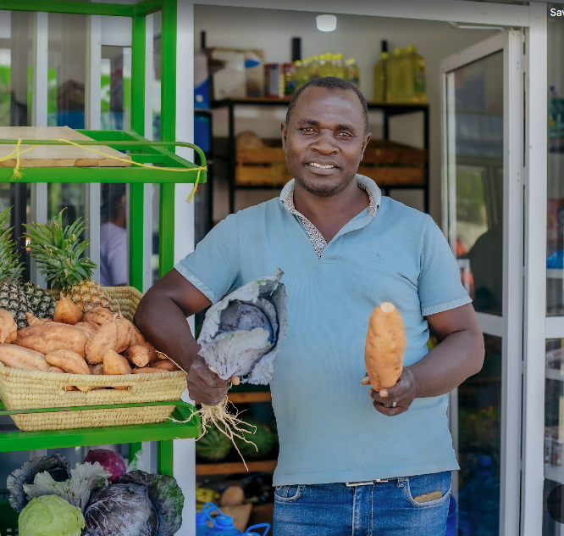
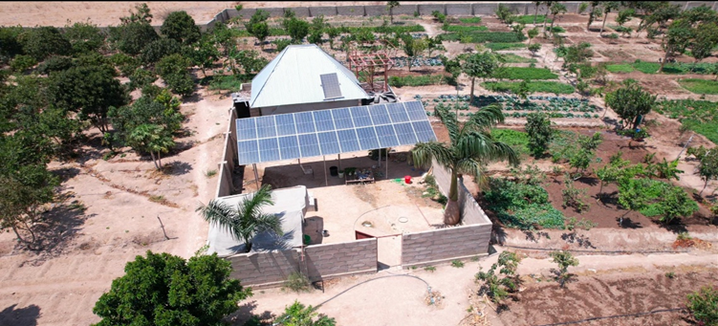
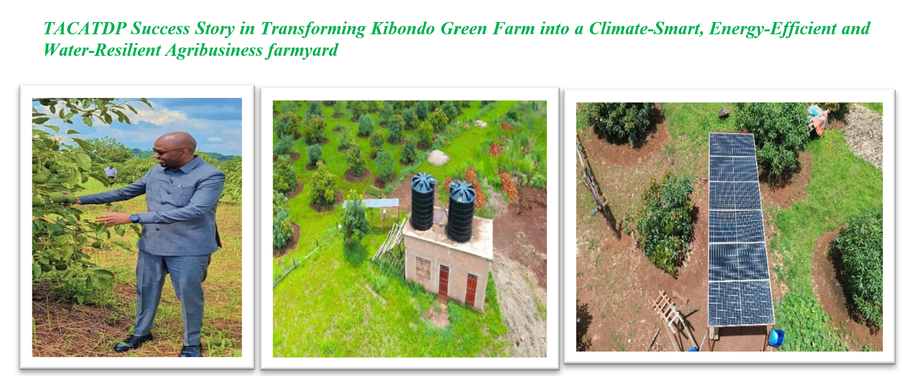
TACATDP impacts in the fields through concessional financing support
TACATDP Transforming Semi-Arid Nchemwa into a Green Horticulture Hub, From Farm to Fresh Produce Supplying Dodoma City

Slide 12
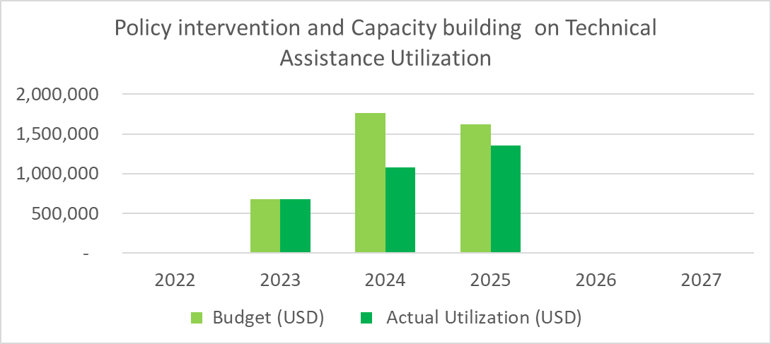
TACATDP Technical Assistance Grant utilization status

Slide 13
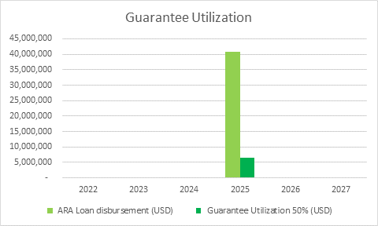
GCF Guarantee utilization status

